Slide 1

Comparative Analysis of Depreciation Methods: Straight-Line vs. Diminishing Balance
Gahyethri Ponnaboina

Slide 2
Topics:-
Introduction
Key Findings
Actionable
Methodologies
Approches
Insights

Slide 3

Introduction
Depreciation is the systematic allocation of the cost of a tangible asset over its useful life. It reflects the reduction in value of an asset as it is used over time.
Depreciation helps in matching the cost of the asset with the revenue it generates. It provides a method to allocate the cost of the asset over its useful life, impacting both the income statement and the balance sheet.
Depreciation also helps in tax deduction, as it is considered an expense.
Depreciation is the accounting process of allocating the cost of a tangible asset over its useful life. It reflects the asset's gradual decrease in value due to wear and tear, obsolescence, or passage of time. This concept is crucial in both financial and tax accounting, ensuring that companies report expenses accurately and do not overstate profits.

Slide 4

Key Findings
Asset Value Declines Over Time :-Tangible assets lose value due to wear and tear, obsolescence, or usage.
Financial & Accounting Significance
Ensures compliance with the matching principle, where expenses are recorded in the same period as the revenue they help generate.
Depreciation Methods Impact Financial Statements
Different methods (Straight-Line, Declining Balance, Units of Production, etc.) result in varying depreciation expenses.
Straight-line method results in consistent expenses over time.

Slide 5

Actionable
Depreciation Expense=Useful Life Cost of Asset−Salvage Value​
Total Depreciation=Cost of Asset−Scrap Value
Look for seasonal patterns in sales and profit to forecast future performance.
Compute depreciation for each year based on the selected method..
✅ Graphical Representation – Show how depreciation changes over time.

Slide 6

Methodologies
Asset Cost (C) – Initial cost of the asset. ✅ Salvage Value (S) – Expected value at the end of its useful life. ✅ Useful Life (N) – Number of years the asset is expected to be
Apply Formula Depreciation per year= The amount of depreciation allocated to each year of the asset's useful life, calculated as (Asset Price - Scrap Value) / Estimated Life Span.
Record Depreciation Expense Annually= Book Value at Beginning of Year * Depreciation Rate.
Diminishing Balance Method (DBM) Methodology:-
Apply Formula
Depreciation per year = Book Value at Beginning of Year * Depreciation Rate.

Slide 7

Approches
The Straight-Line Method (SLM) is one of the simplest and most commonly used depreciation techniques.
t spreads the asset’s cost evenly over its useful life. To ensure accurate implementation, businesses can adopt different approaches based on their financial goals, reporting needs, and regulatory requirements.
Choosing the right approach depends on business objectives—whether it’s financial reporting, tax planning, asset management, or cost control.
The Diminishing Balance Method (DBM) is an accelerated depreciation approach that assigns higher depreciation in the early years of an asset’s life and reduces it gradually over time.
To ensure effective application, businesses can adopt different approaches based on financial objectives, reporting standards, and asset management strategies.

Slide 8
Insights
While depreciation doesn’t involve an actual cash outflow, it reduces taxable income, which can free up cash for business operations and investments.
Straight-Line Method offers consistency but may not reflect actual asset usage patterns.
Businesses can use accelerated depreciation methods to reduce taxable income in high-revenue years.
Timing asset purchases at the end of a fiscal year can provide tax benefits sooner.
Recognizes that assets lose value faster at the beginning of their useful life.

Slide 9
Conclusion
Both methods have their own merits and are suitable for different types of assets and business scenarios.
The choice of method depends on the nature of the asset and the business's financial strategy.
For assets that provide consistent utility over time, the Straight Line method is recommended due to its simplicity and uniform expense allocation.
However, businesses should carefully assess their financial strategy before choosing this method, as it results in fluctuating expense patterns. Selecting the right depreciation method depends on asset type, financial goals, and regulatory requirements.

Slide 10

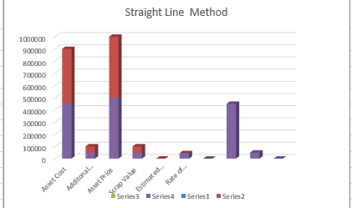
Graps

Slide 11
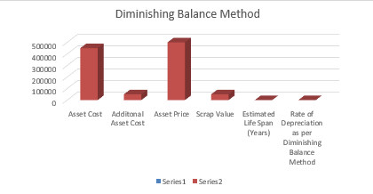

Slide 12
